Slide 1
Admissions data
Winnie .K. Yaa
Thursday,16,July,2015

Slide 2
SYNOPSIS
This is a presentation on the analysis I made on the admissions data. This data was mostly comprised of dates i.e. the date of birth and admission of the patients, the date of discharge, the serial and PID no. of the patients.
In order to work with dates I first changed the date formats using functions found in R.
Thereafter I generated quite number of graphs and summaries but we will take a look at the general admissions graphs against age groups and also against the months patients were admitted.

Slide 3
Data analysis:
The data was analysed using the R software. Document, tables and graphs were also generated using R.

Slide 4
R packages used in the analysis:
- Plyr: Has a set of tools for a common set of problems. Used to split up a big data structure into homogeneous pieces, apply a function to each piece and then combine all the results back together. For example, calculate summary statistics for each group.
- dplyr: This is a data manipulation package containing different functions like select(),filter(),mutate(),sort(),arrange() and distinct().
- lubridate: This is an R package that makes dealing with dates faster. Since the data that I was working on was mostly in dates format hence the need to change the formats.
- ggplot2: This is a package that contains graphics used for data presentation.

Slide 5
Tables AND GRAPHS:

Slide 6
Below is a table of admissions count and age group.
Age Group | Admission Count
Under 1yr | 25,257
1-5 yrs. | 26,382
11-15 yrs. | 1,386
16-20 yrs. | 22

Slide 7
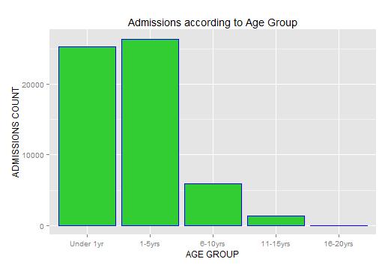
Below is a graph of admissions count against age group.

Slide 8
Below is a table of admissions count and the months of the year.
Month of The Year | Admission Count
January | 5,487
February | 4,587
March | 4,889
April | 4,745
May | 5,390
June | 5,428 Increase
July | 5,472
August | 4,740
September | 4,167
October | 4,186
November | 4,802
December | 5,216

Slide 9
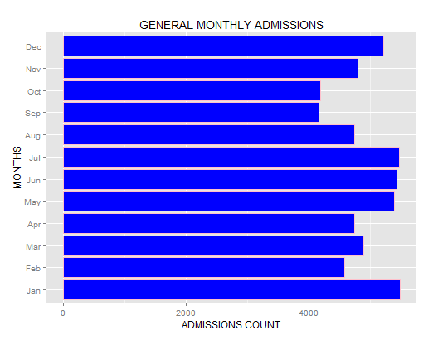
Below is a graph of admissions count against months of the year.

Slide 10
Summary:
Based on the graph and table of admissions count against age group, it is noted that the 1-5yrs age group recorded the highest number of admissions while the least admitted age group was that of 16-20yrs.
From the table and graph of admissions count against months of the year, its clear that the month of January experienced the highest patients turnout most of them from the 1-5yrs age group while September had the least number of patients admissions.
I also noted that there was a slight increase in admissions from the months of May to July and this increase was noted in the 1-5yrs age group.

Slide 11
Assumptions:
The following are general assumptions that I made based on the summaries(tables & graphs) of the admissions data.
High admissions in the month of January especially the 1-5yrs age group may be as a result of the high temperatures experienced during this time of the year. Also dusty winds are a normal occurrence in this month. These weather conditions increases the chances of patients under the said age group the risk of suffering from respiratory diseases like asthma.
Also the admissions can be as a result of different skin infections caused by the high temperatures especially at night during this particular month.
The slight increase in admissions from the months of May to July may be assumed to be due to the cold and rainy weather conditions experienced during these times of the year.

Slide 12
Assumptions cont’d
The age group that had high admissions during these particular months are those between "1-5yrs" because their body immune system is still very weak hence they cannot cope with the low temperatures. Most of them stand a risk of getting respiratory infections like pneumonia.
The increased admissions may also be assumed to be because of the high risk that children especially in this age group (1-5yrs) face on Malarial infection that is at its highest peak during the rainy seasons.

Slide 13
Acknowledgement:
Supervisors: IT Department
Greg Fegan
Kennedy Mwai
Fellow attaches:
Esther .D.
Kelvin .C.
Duncan. N.
Shaha .M.
THANK YOU…

